Slide 1
e-Content for B.Sc Physics Honours students of
RAM RATAN SINGH COLLEGE,
A CONSTITUENT UNIT OF PATLIPUTRA UNIVERSITY,
MOKAMA, PATNA
TOPIC: MODULATION AND DEMODULATION
DR. AYAN MUKHERJEE
ASSISTANT PROFESSOR
RAM RATAN SINGH COLLEGE,
A CONSTITUENT UNIT OF PATLIPUTRA UNIVERSITY,
MOKAMA, PATNA

Slide 2
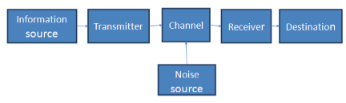
Communication System
The transmission of information from the sender to the recipient through some medium is called as communication.
What is transmitted?
Mainly Audio, vedio and other data. They are mainly in low frequency range.
Although it is common in our perceptual experience that sending or receiving signals or data is simple, but it involves quite complex procedures, possibilities and scenarios within the communication systems.

Slide 3
During communication we face following problems:
Long distance transmission:
Low frequency signals get attenuated quickly in space while high frequency do not get attenuated in space as fast as low frequency and can travel along long distance. This happens as energy of signal is proportional to frequency. Thus if low frequency are used for some application then strength will be less, resulting poor reception.
2. Antenna Size:
The antenna size is inversely proportional to the frequency of the radiated signal. The order of the antenna aperture size is at least 1/10 th ( or ¼ th ) of the wavelength of the signal. Its size is not practicable if the signal is 5 KHz; therefore, raising frequency by any process is required to reduce the size of the antenna.

Slide 4
3. Noise to signal ratio:
Electrical noise is one of the principle limiting factors in the performance of communication systems. The signal-to-noise ratio indicates the relative strengths of the signal and the noise in a communication system. The stronger the signal and the weaker the noise, the higher the SNR.
4. Interference of different transmitted wave:
In signal transmission, the signals from various sources are transmitted through a common channel simultaneously by using multiplexers. If these signals are transmitted simultaneously with certain bandwidth, they cause interference.
5. Cost of Instruments:
Cost of instruments used in low frequency range is very high compared to high frequency based instruments.

Slide 5
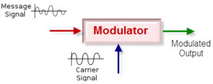
What is Modulation?
Modulation is a process of changing the characteristics of the wave to be transmitted by superimposing the message signal on the high frequency signal. In this process video, voice and other data signals modify high frequency signals – also known as carrier wave. This carrier wave can be DC or AC or pulse chain depending on the application used. Usually high frequency sine wave is used as a carrier wave signal.
In modulation technique, the message signal frequency is raised to a range so that it is more useful for transmission.

Slide 6
Why modulation is used in communication?
1. Reduction in the height of antenna
2. Avoids mixing of signals
3. Increases the range of communication
4. Multiplexing is possible
5. Improves quality of reception
The above points describe modulation’s importance in communication system. Modulation is important to transfer the signals over large distances, since it is not possible to send low-frequency signals for longer distances. Similarly, modulation is also important to allocate more channels for users and to increase noise immunity.

Slide 7
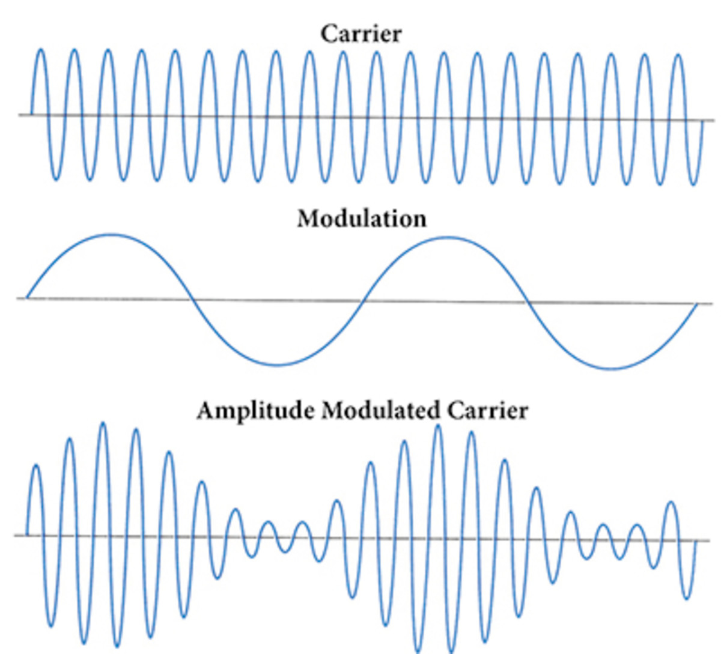
Message Signal: It contains the information and in general of low frequency.
Carrier Signal: Used to transmit the message signal and of high frequency.
Modulated Signal: The resultant signal due to modulation.
Message Signal

Slide 8
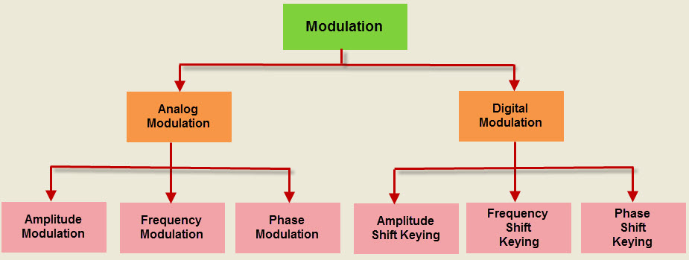

Slide 9
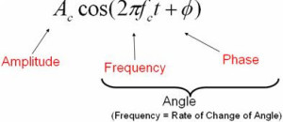
Analog Modulation:
In this modulation, a continuously varying sine wave is used as a carrier wave that modulates the message signal or data signal. The Sinusoidal wave’s general function is shown in the figure below, in which, three parameters can be altered to get modulation – they are amplitude, frequency and phase, so the types of analog modulation are:

Slide 10
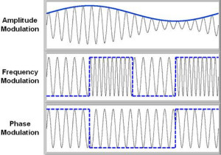
Amplitude Modulation:
Amplitude modulation was the earliest modulation technique used to transmit voice by radio. This type of modulation technique is used in electronic communication. In this modulation, the amplitude of the carrier signal varies in accordance with the message signal, and other factors like phase and frequency remain constant.
The modulated signal is shown in the below figure, and its spectrum consists of the lower frequency band, upper frequency band and carrier frequency components. This type of modulation requires more power and greater bandwidth; filtering is very difficult. Amplitude modulation is used in computer modems, VHF aircraft radio, and in portable two-way radio

Slide 11
Frequency Modulation:
In this type of modulation, the frequency of the carrier signal varies in accordance with the message signal, and other parameters like amplitude and phase remain constant. Frequency modulation is used in different applications like radar, radio and telemetry, seismic prospecting and monitoring newborns for seizures via EEG, etc.
This type of modulation is commonly used for broadcasting music and speech, magnetic tape recording systems, two way radio systems and video transmission systems. When noise occurs naturally in radio systems, frequency modulation with sufficient bandwidth provides an advantage in cancelling the noise
Phase Modulation:
In this type of modulation, the phase of the carrier signal varies in accordance with the message signal. When the phase of the signal is changed, then it affects the frequency. So, for this reason, this modulation is also comes under the frequency modulation.
Generally, phase modulation is used for transmitting waves. It is an essential part of many digital transmission coding schemes that underlie a wide range of technologies like GSM, WiFi, and satellite television. This type of modulation is used for signal generation in al synthesizers, such as the Yamaha DX7 to implement FM synthesis.

Slide 12
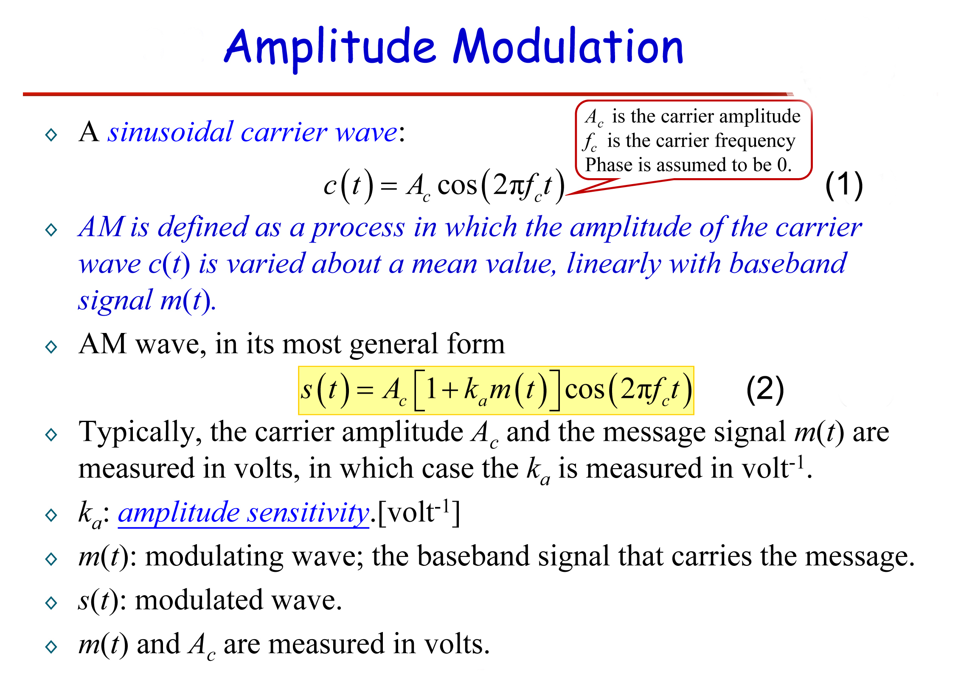

Slide 13
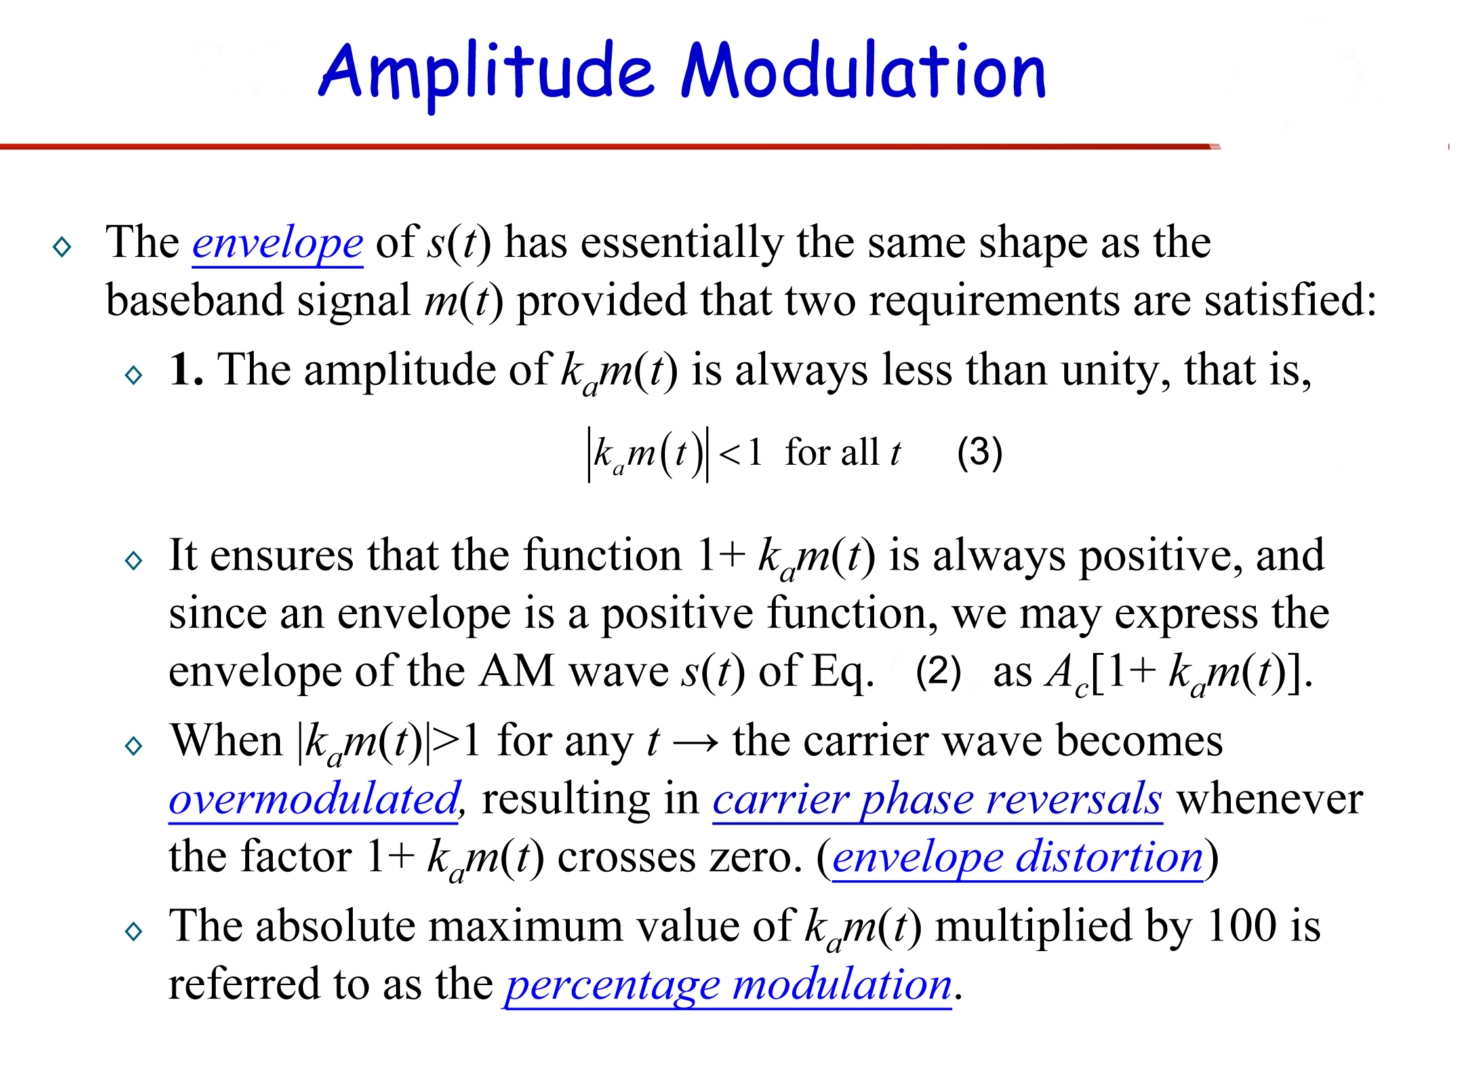

Slide 14
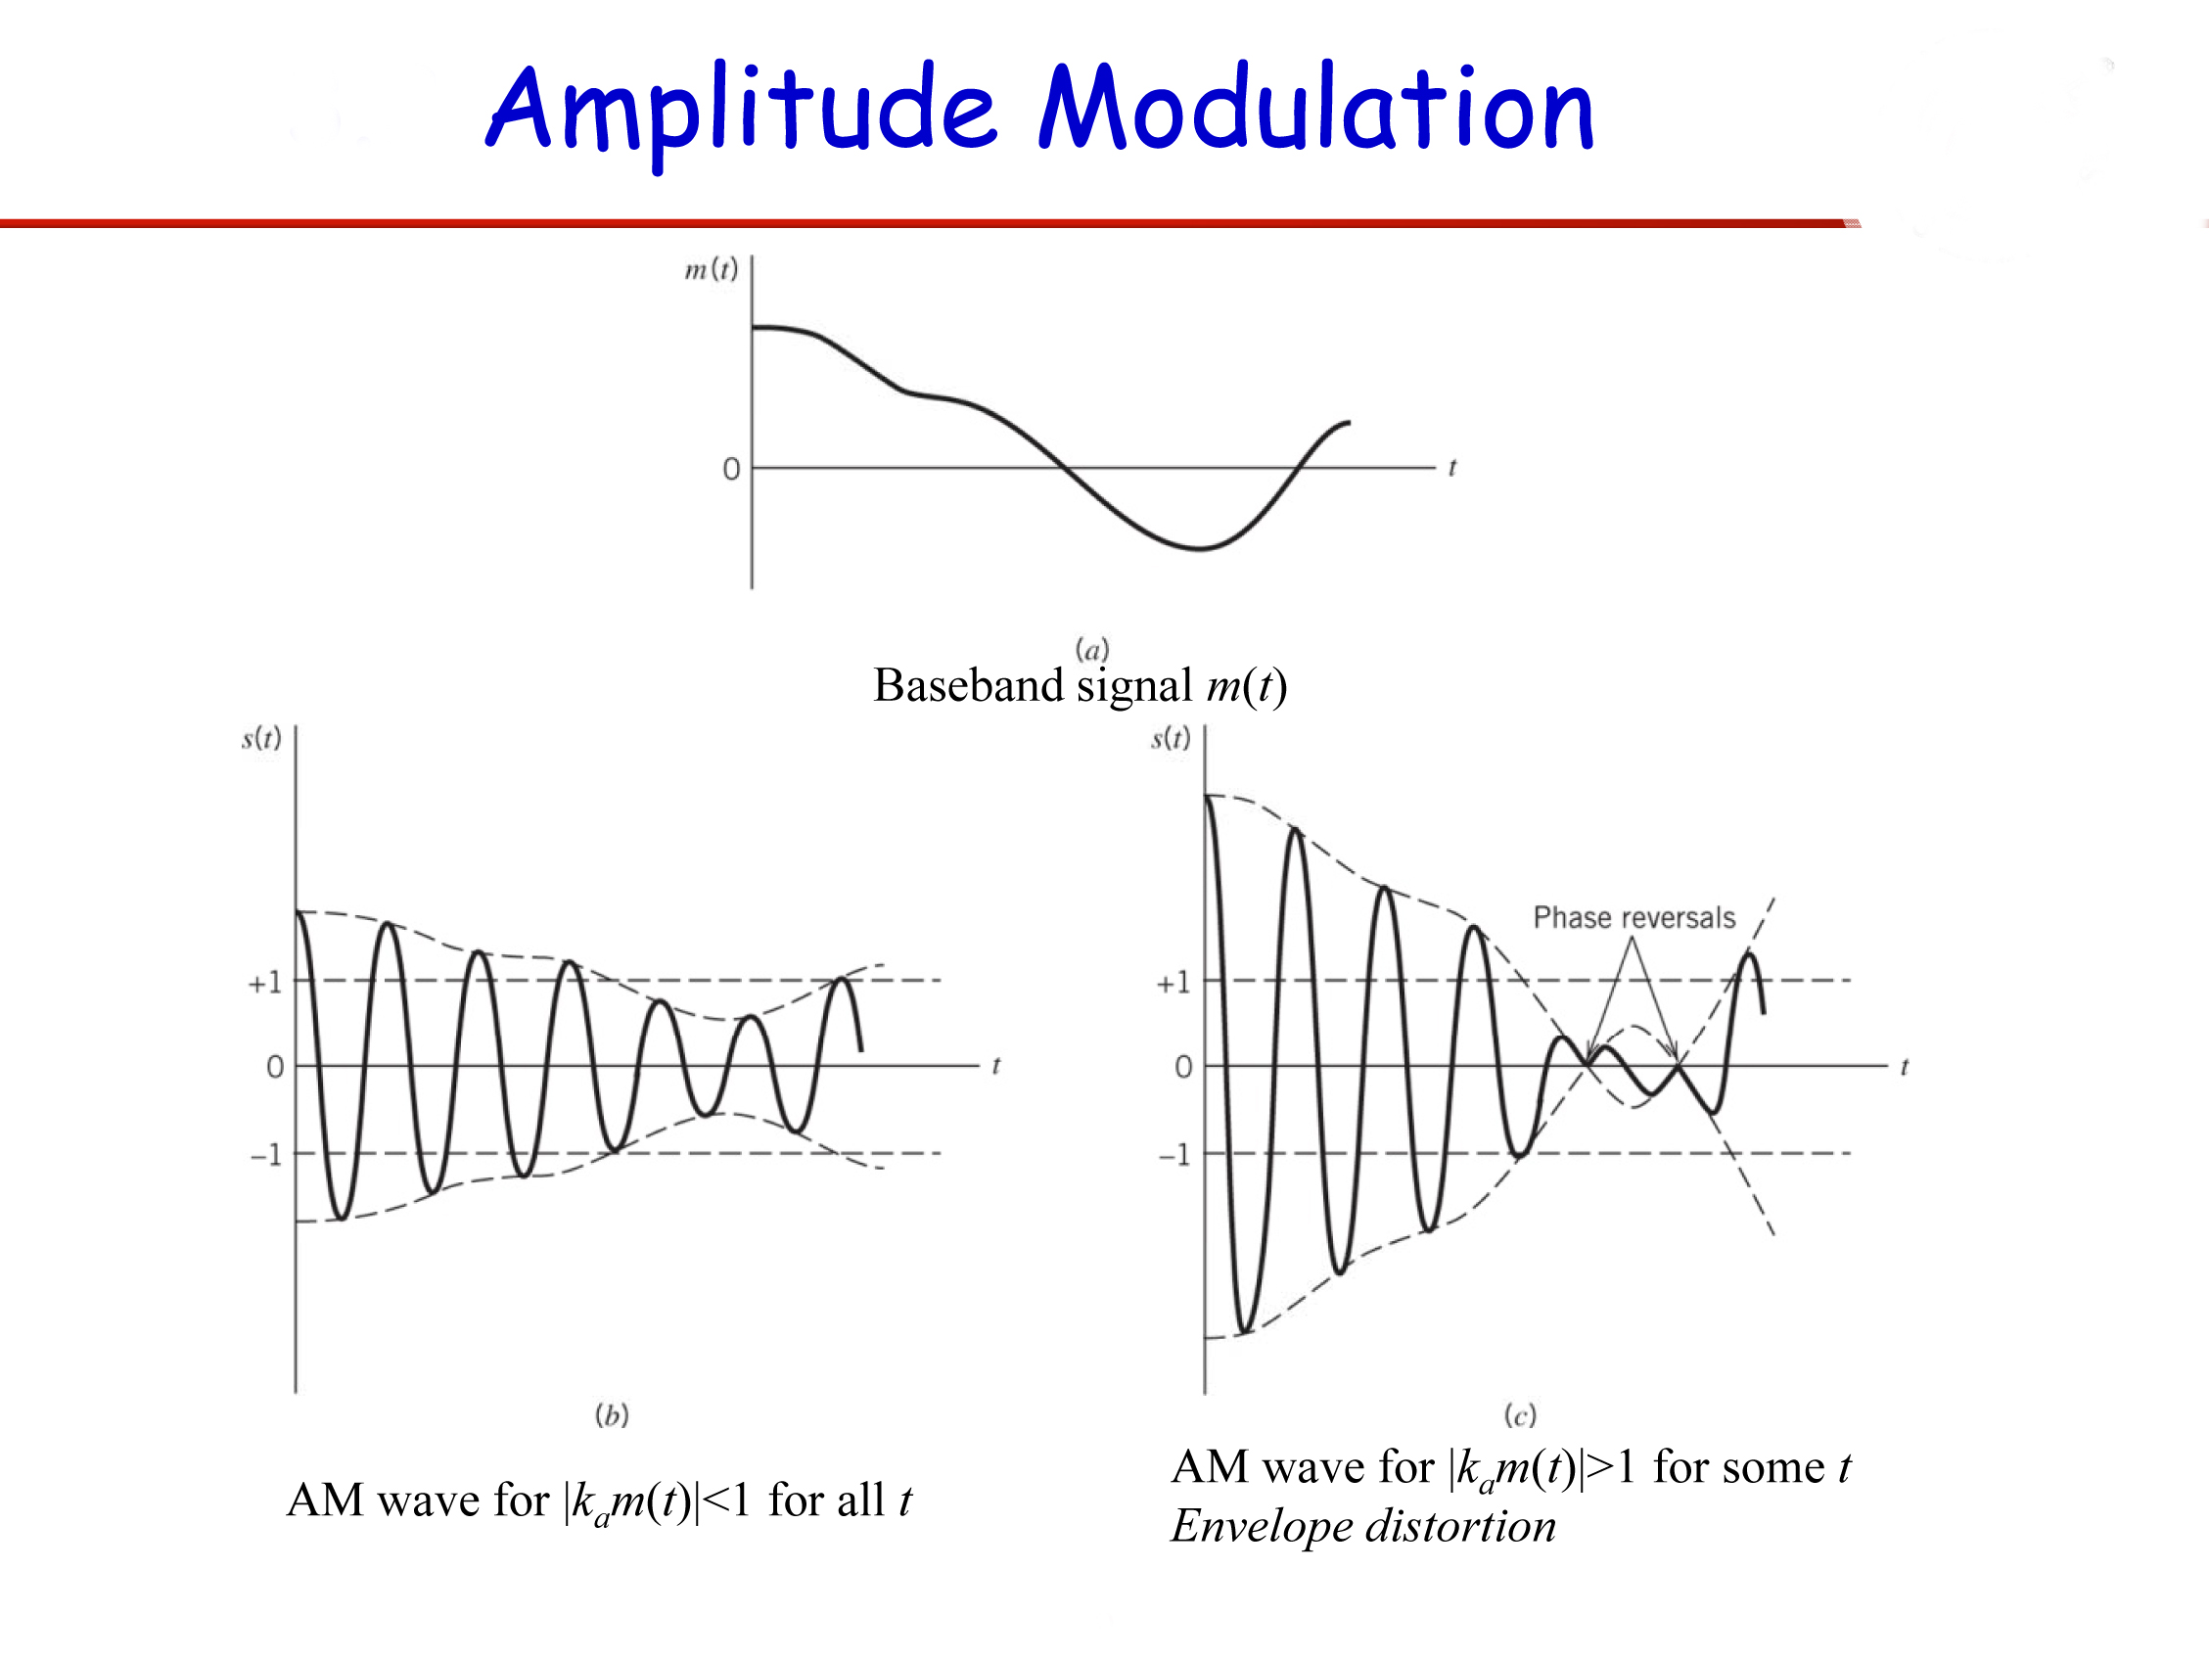

Slide 15
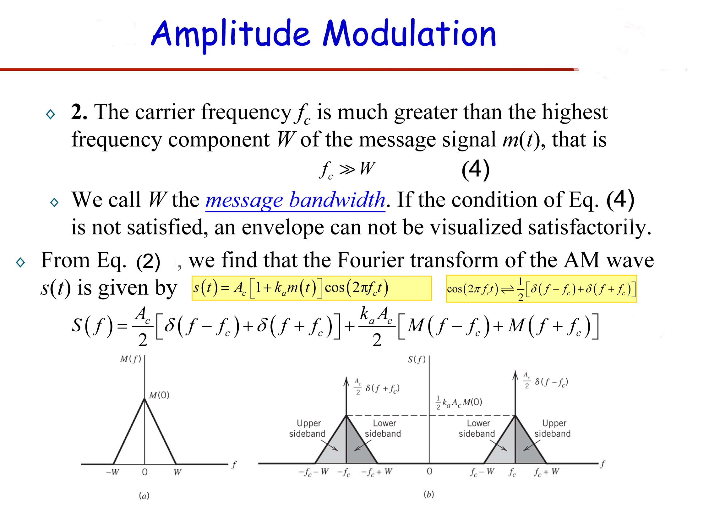

Slide 16
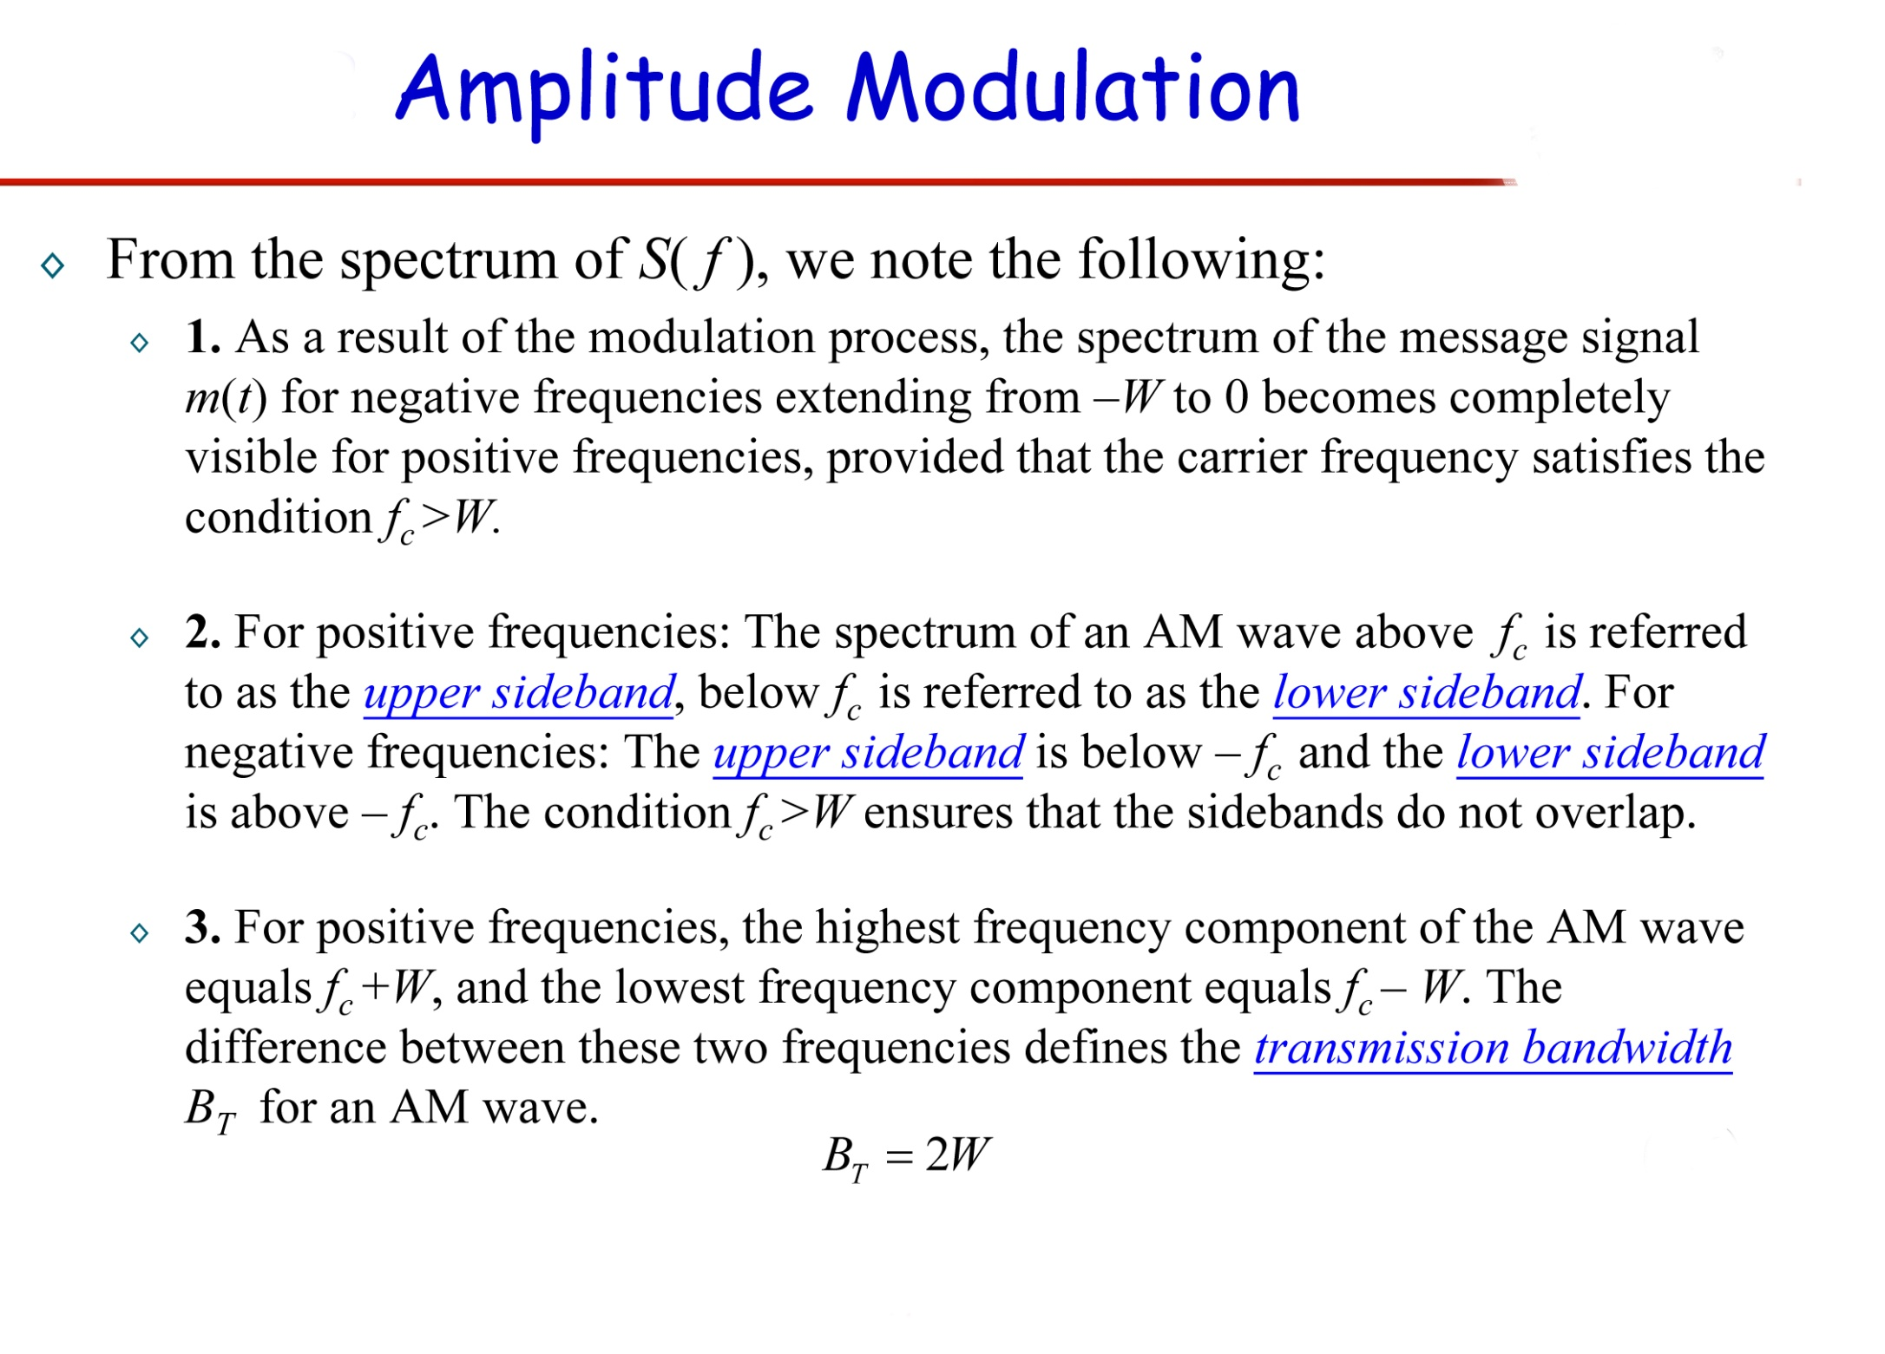

Slide 17
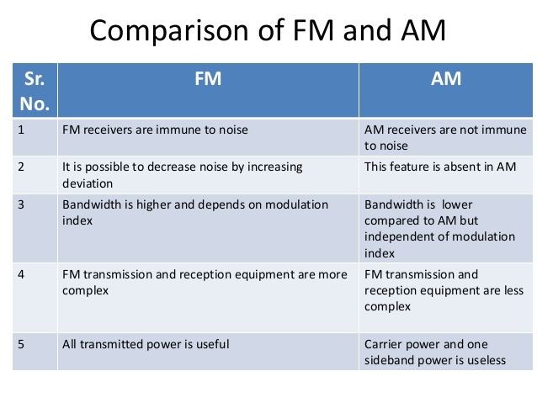

Slide 18



